Slide 1
Interactive
Online Curricula and Resources for 125,000 nanoHUB.org Users
Gerhard Klimeck
Director
Network for Computational Nanotechnology (NCN)
Electrical and Computer Engineering
gekco@purdue.edu
University Materials Council Meeting
Northwestern University, June 23, 2010

Slide 2
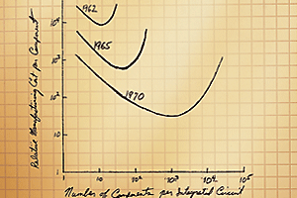
1965
Gordon Moore
http://www.intel.com/technology/mooreslaw
Relative Manufacturing Cost per Component
Number of Components per Integrated Circuit

Slide 3
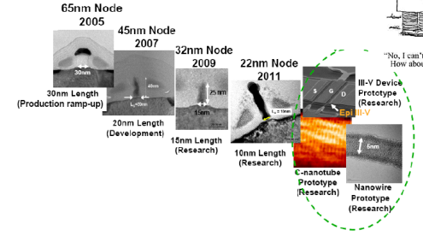
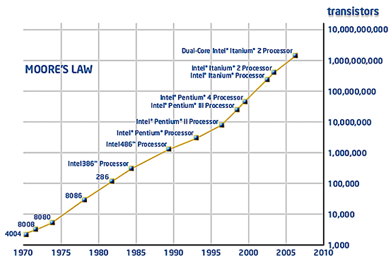
Intel in 2009
Device Size:
Tens of nanometers
Stanford SUPREM
Robert
Robert
Chau
Chau
(Intel), 2004
(Intel), 2004
http://www.intel.com/technology/mooreslaw/index.htm
Device Integration:
>2 Billion
Berkeley SPICE

Slide 4
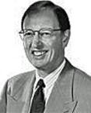
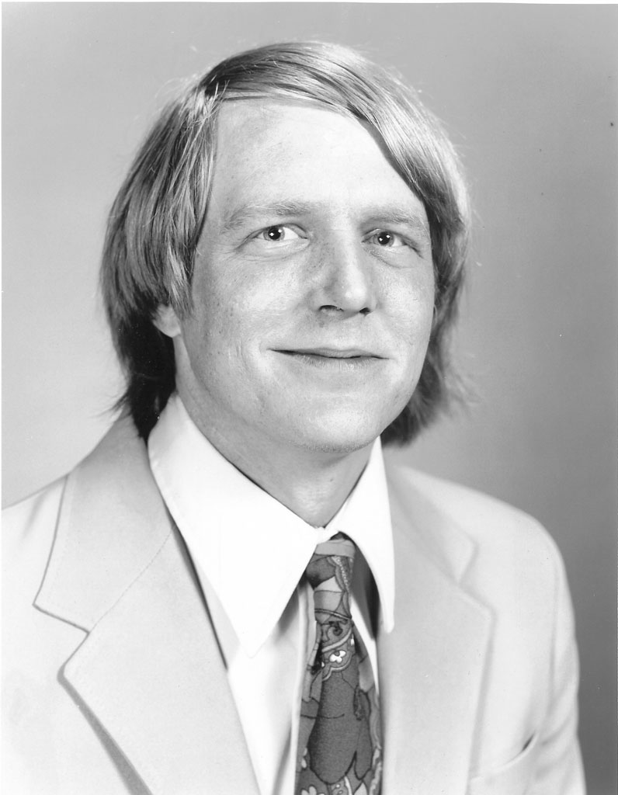
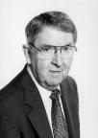
Berkeley
Simulation Program with Integrated Circuit Emphasis.
from: Larry Nagel, BCTM ‘96
Started as a class project
Developed as a teaching tool
Quality control: pass Pederson
Dissemination:
  Public domain code
  Pederson carried tapes along
  Students took it along
  to industry and academia
Released 1972
Ronald
A. Rohrer
Laurence
W. Nagel
http://www.omega-enterprises.net/
Donald O.
Pederson

Slide 5
Stanford
Stanford University PRocEss Modeling
Stanford wanted to mimic
Berkeley success
Combine various existing models
Dissemination:
  Public domain code
  Community workshops
  Students took it along
  to industry and academia

Slide 6
Birth of an Industy
Process
Simulation
Device Size
Intel Capitalization:
$85B
Total Industry:
$280B
Transistors
Circuit
Simulation
Years

Slide 7



Moore’s Law for Other Disciplines?
Nano Initiatives
nano-scale
structures
Device Size
Electronics
Materials
Research
Photonics
Mechanics
Transistors
Billions of nano
structures
Bio/Medicine
Years

Slide 8
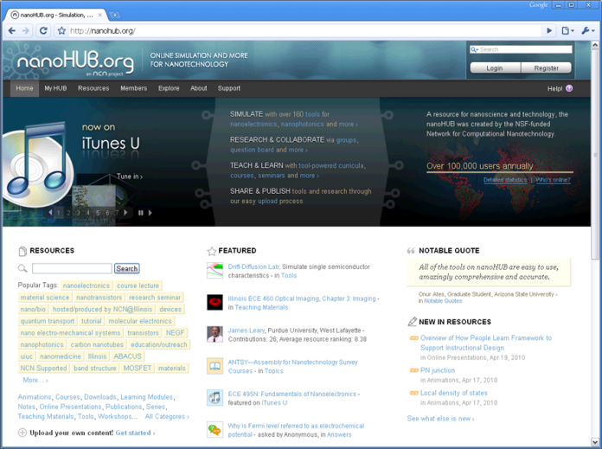
It Happens Here

Slide 9


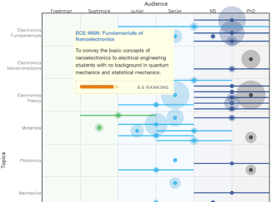





































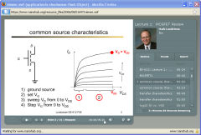
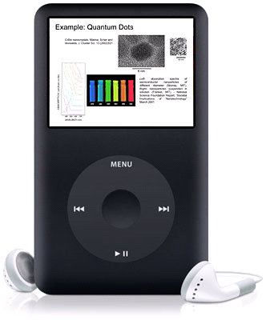
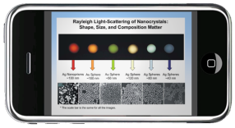
Over 2,100 Resources!
170 tools
43 courses
1,557 seminars and
teaching materials

Slide 10
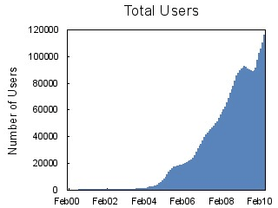
World-Wide Community
116,000 users worldwide
As much traffic as www.purdue.edu
Users at all Top 50 US Engr Schools
19% of all .edu domains
116 classes at 76 institutions in 2009
8,200 users ran 345,000 simulations
172 countries
Demo>>

Slide 11
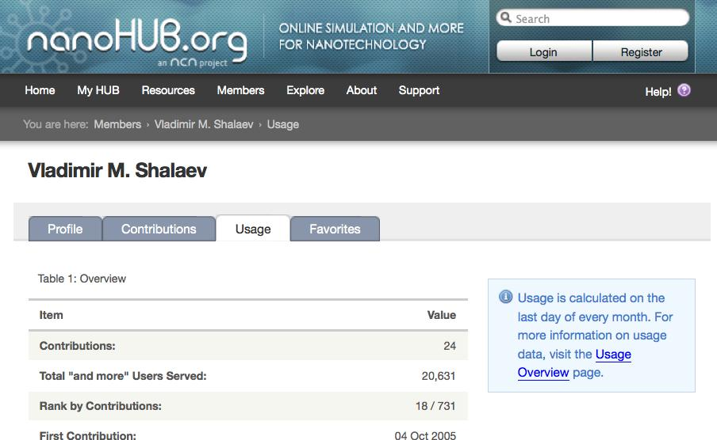
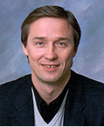
A course on nanophotonics

Slide 12
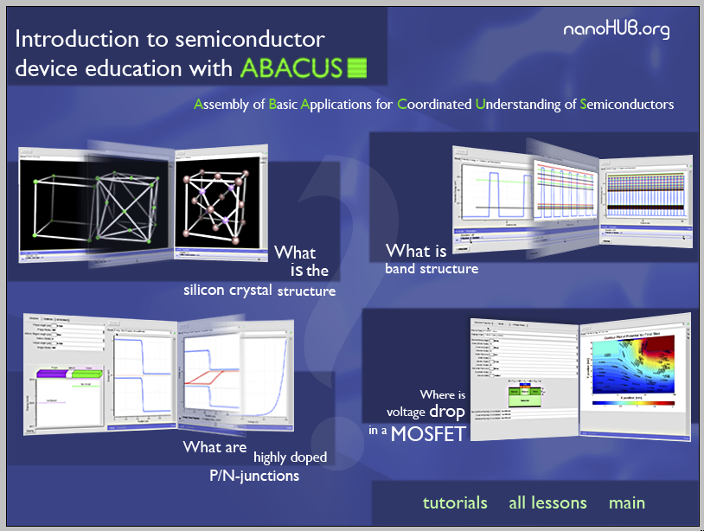

Slide 13
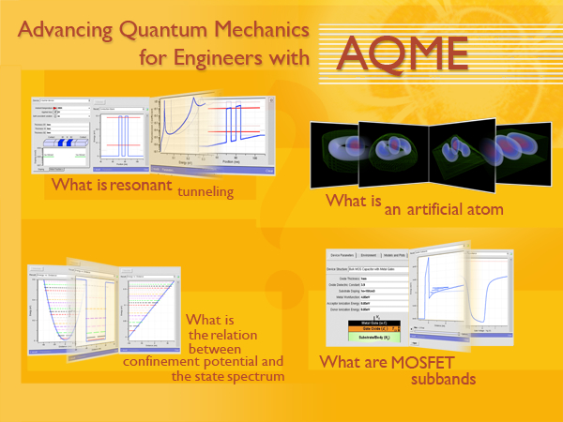

Slide 14
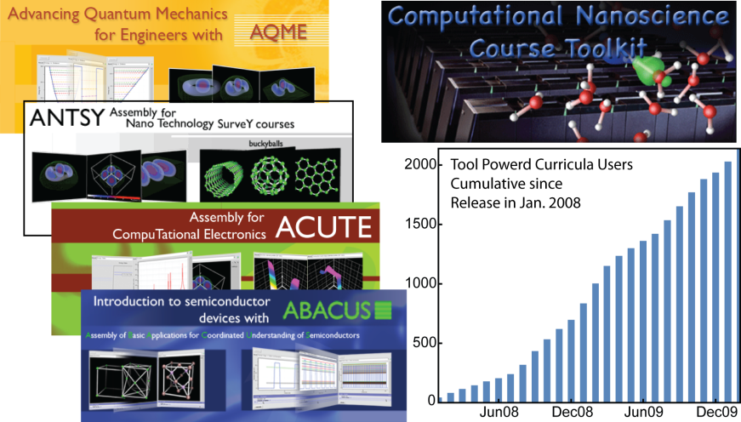
Tool Powered Curricula
“make abstract concepts more concrete”

Slide 15
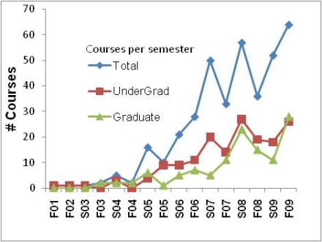
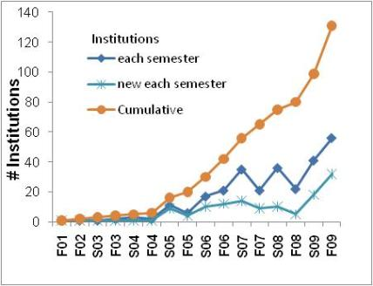
Use in the classroom
In the year 2009:
116 classes; 76 institutions; 23 countries

Slide 16
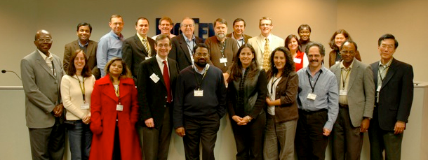
Work with Teachers
Educational workshop:
November 5-6, 2009, Chicago Airport
11 faculty
11 institutions / 8 primarily serving minorities

Slide 17
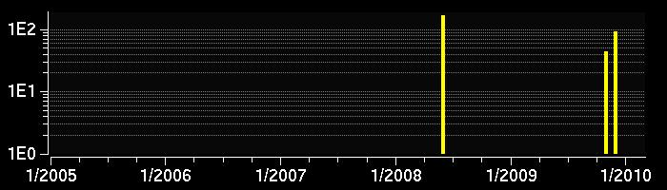
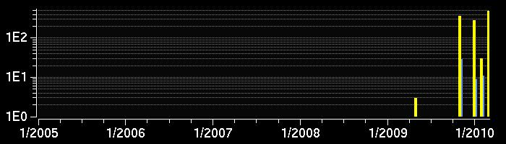
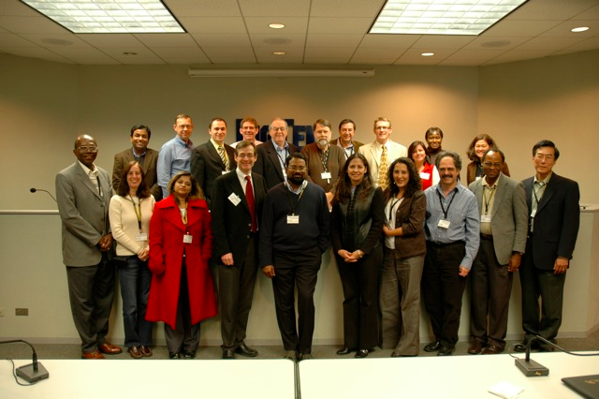
Immediate Impact
Hasina Huq
UT Pan Am.
UT Pan Am.
11 Simulation users
Tanya Faltens
Cal Poly Pomona
Cal Poly Pomona
53 Simulation users

Slide 18
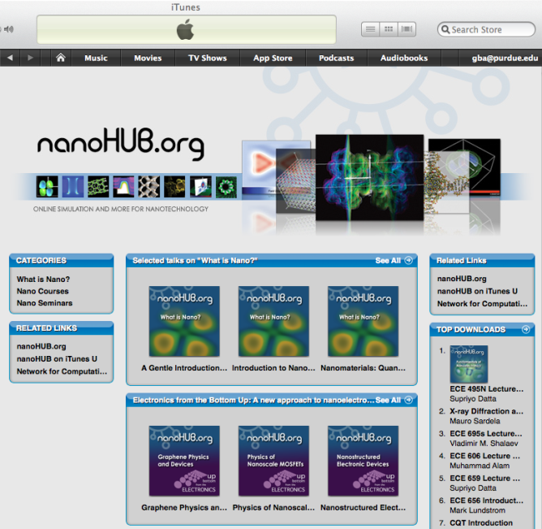







nanoHUB on iTunes U
Exclusive - Apple VP OK’ed
- one of 68 orgs
New York
Public
Library
Notes:
No advertizing other than word of mouth and people searching the iTunes U Beyond Campus site.

Slide 19
nanoHUB on iTunes U
Nov 2009 start
350 content items today
55,000 downloads
~10,000 downloads/month
Notes:
No advertizing other than word of mouth and people searching the iTunes U Beyond Campus site.

Slide 20
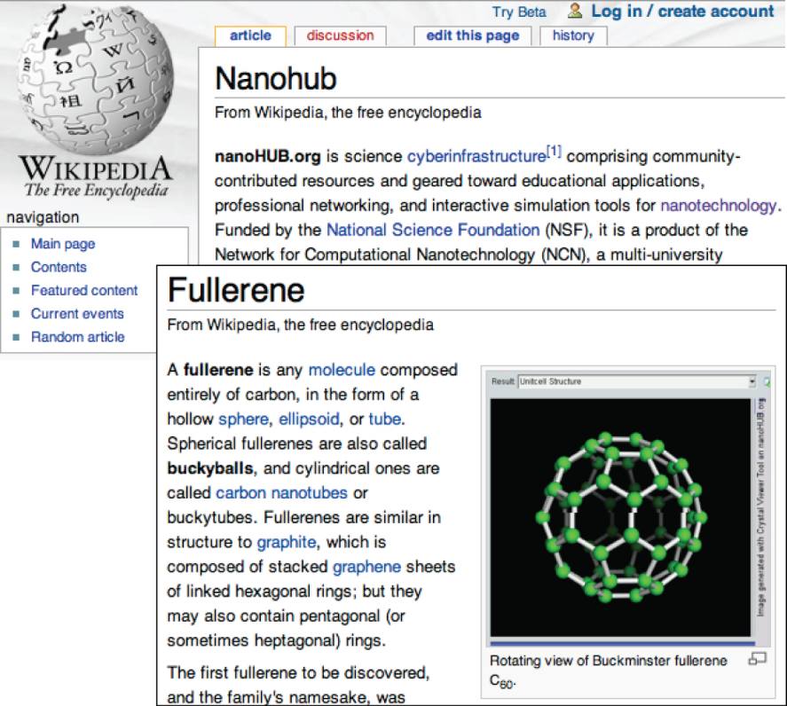
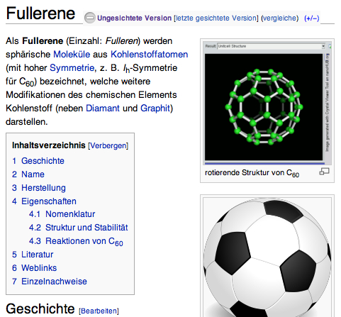
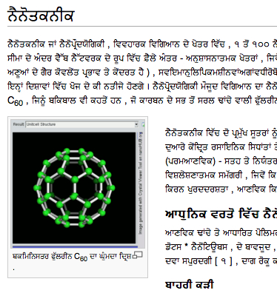
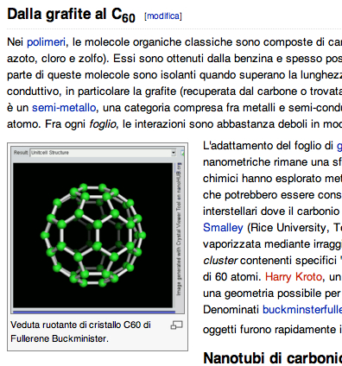
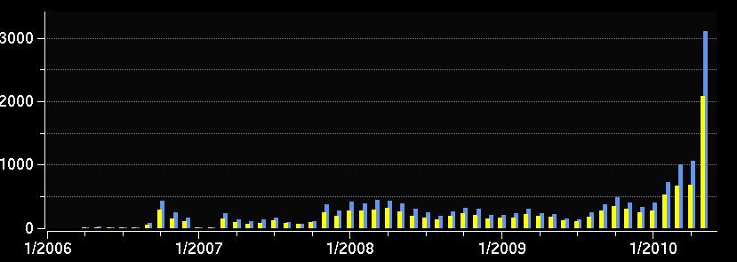
Wikipedia Contributions
Punjabi
German
Italian
16 animations deployed Jan 2010 on ~30 pages
Brings 2,000 visitors for 3,300 visits monthly

Slide 21
Research Impact
nano-scale
structures
Device Size
Electronics
Materials
Research
Photonics
Mechanics
Transistors
Billions of nano
structures
Bio/Medicine
Years

Slide 22
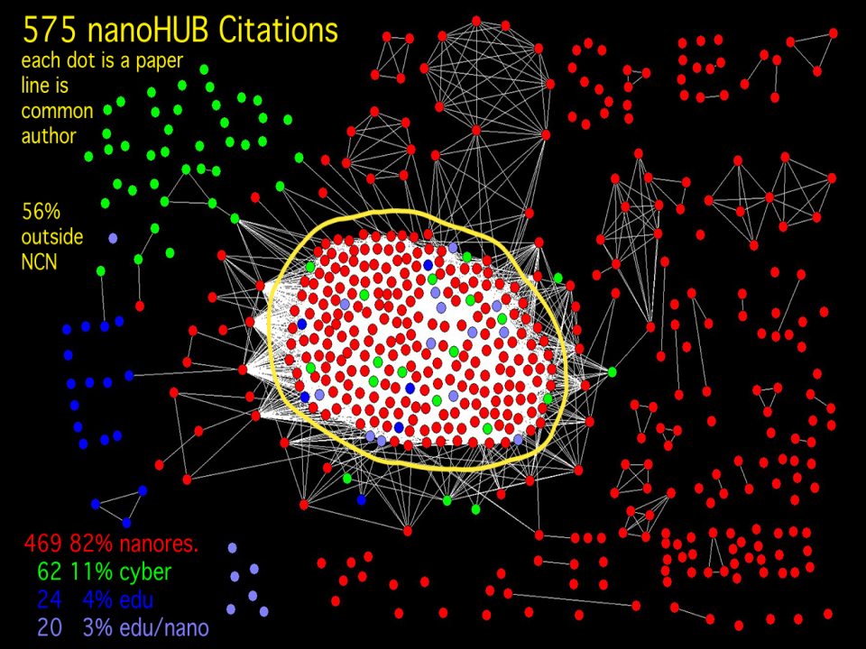
22
22

Slide 23
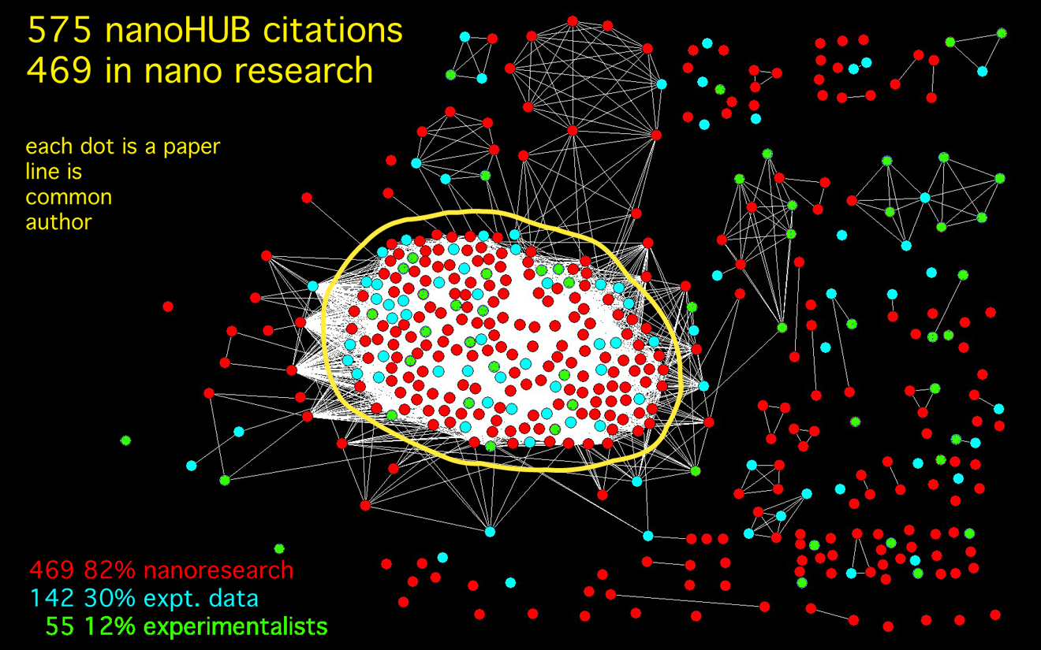
23
23

Slide 24

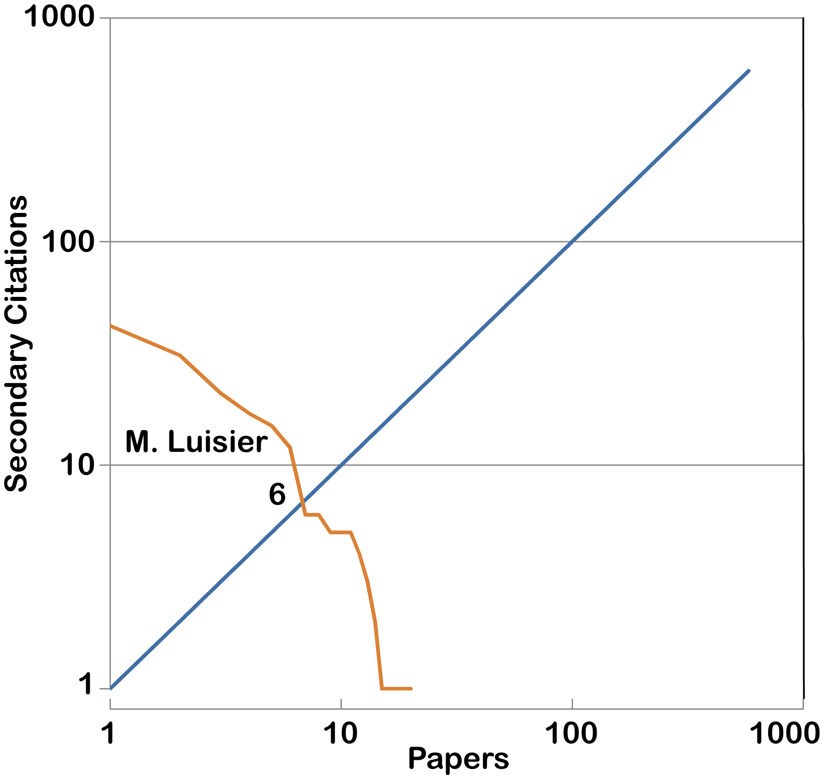
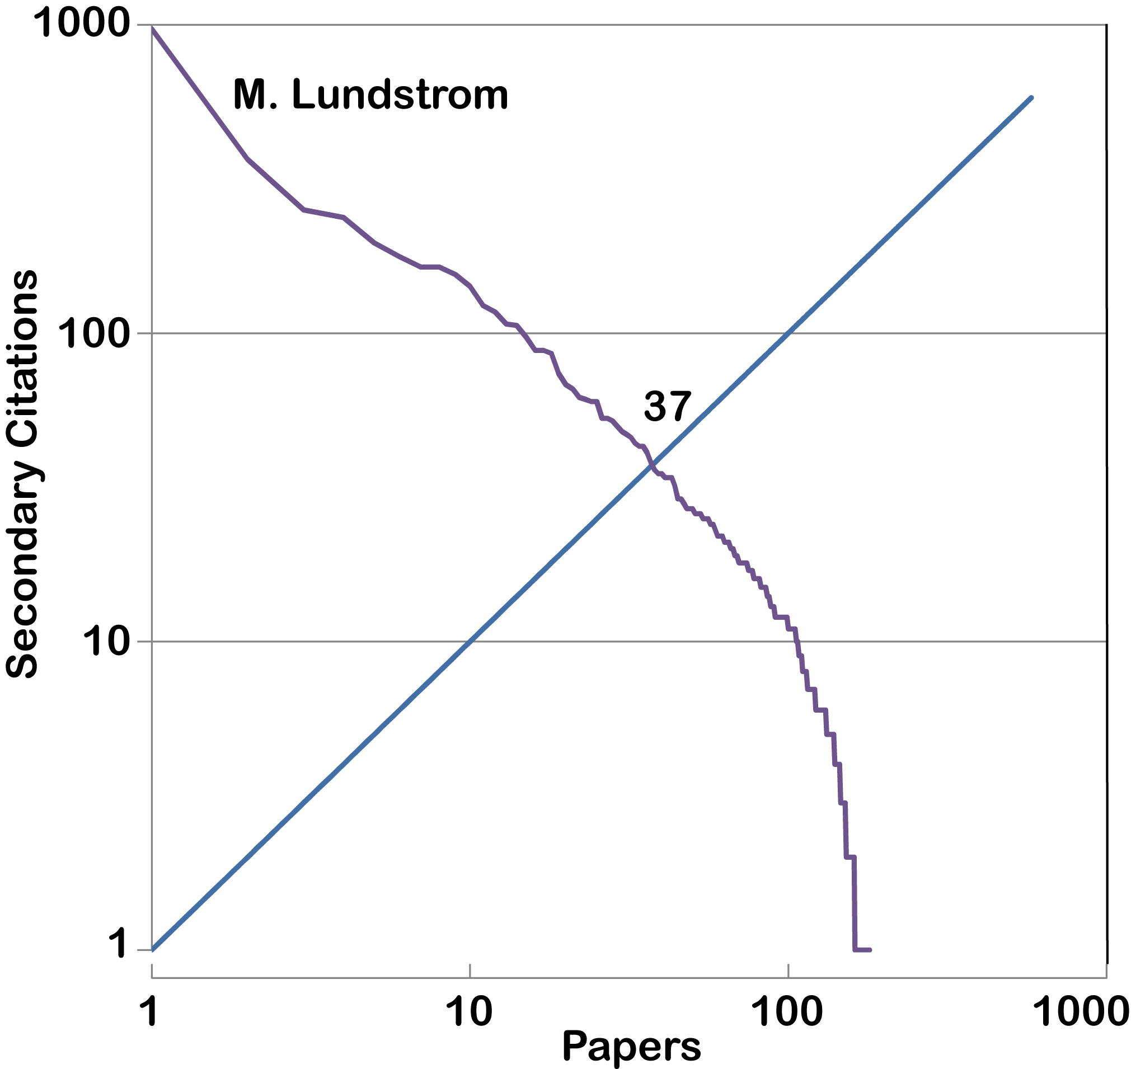
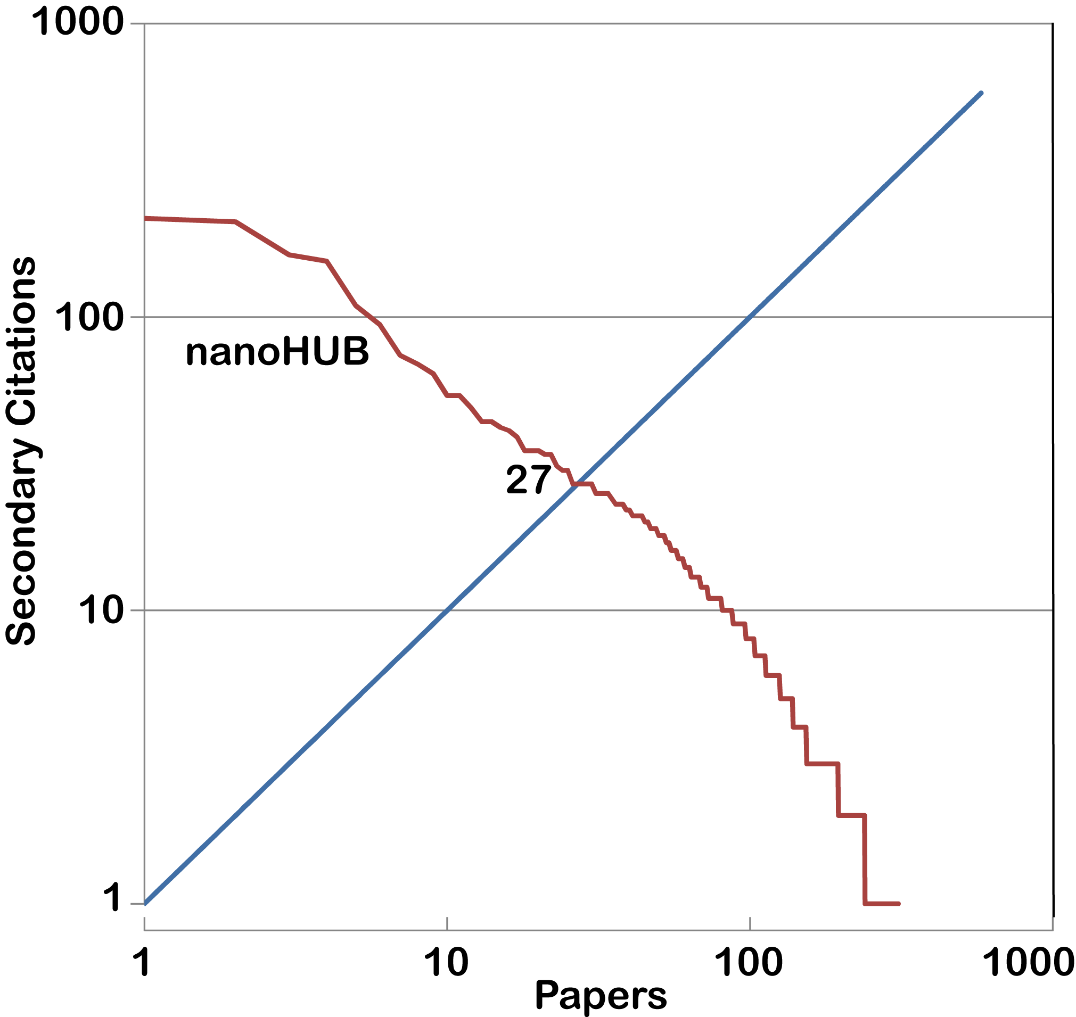
Research: Publish or Perish
575 nanoHUB citations
>3,200 secondary citations
h-index: 27
24

Slide 25
Use by Experimentalists:
Schred
TCAD simulations using SCHRED [15] or ISE, …., were used to support our analysis and compute the inversion carrier profiles in the devices.
Effect of channel positioning on the 1∕ f noise in silicon-on-insulator metal-oxide-semiconductor
M von Haartman, M Oestling,
Journal of Applied Physics, 2007 - link.aip.org...

Slide 26
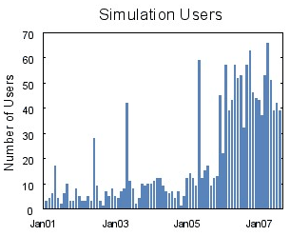
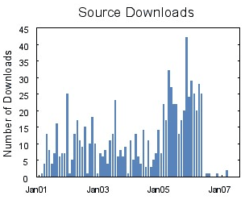
Dual Use in Research and Education
Rappture version Feb 06
TCAD simulations using SCHRED [15] or ISE, …., were used to support our analysis and compute the inversion carrier profiles in the devices.
371 Users
Last 12 months
  User Interfaces are
  absolutely critical!
Effect of channel positioning on the 1∕ f noise in silicon-on-insulator metal-oxide-semiconductor
M von Haartman, M Oestling,
Journal of Applied Physics, 2007 - link.aip.org...
Same behavior across all similar converted tools
User’s don’t have to download/install software

Slide 27
The Next Generations
nano-scale
structures
Device Size
Tools
Researchers
Careers
Transistors
Billions of nano
structures
Years

Slide 28

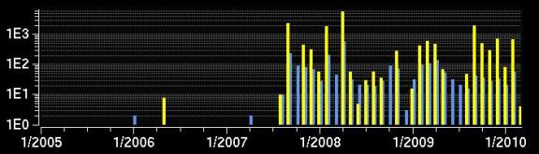
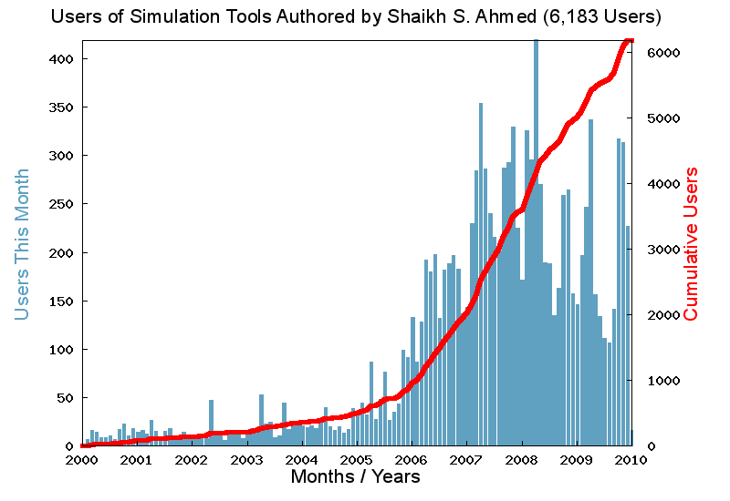

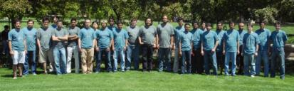
Next Generation Faculty:
  Usage at SIUC
  Shaikh Ahmed
Post Doc
at Purdue
Faculty at
SIUC
6,183 users
8 tools
  Infused nanoHUB into existing classes
  Built a new nanoelectronics curriculum
  Used nanoHUB for research
Get images from annual report
  Recently Dr. Ahmed was promoted to tenured Associate Professor. I would like to emphasize that Dr. Ahmed's use of nanoHUB in education and research, which earned him national and international visibility, did play a significant positive role in his early promotion case.
Glafkos Galanos
Chair, Dept. of Electr. and Comp. Eng, SIUC

Slide 29

Any Science Gateway’s Dream
Why is it so hard?
Any
Science
Change…
Research
..the..
Any
Engineering
...world

Slide 30
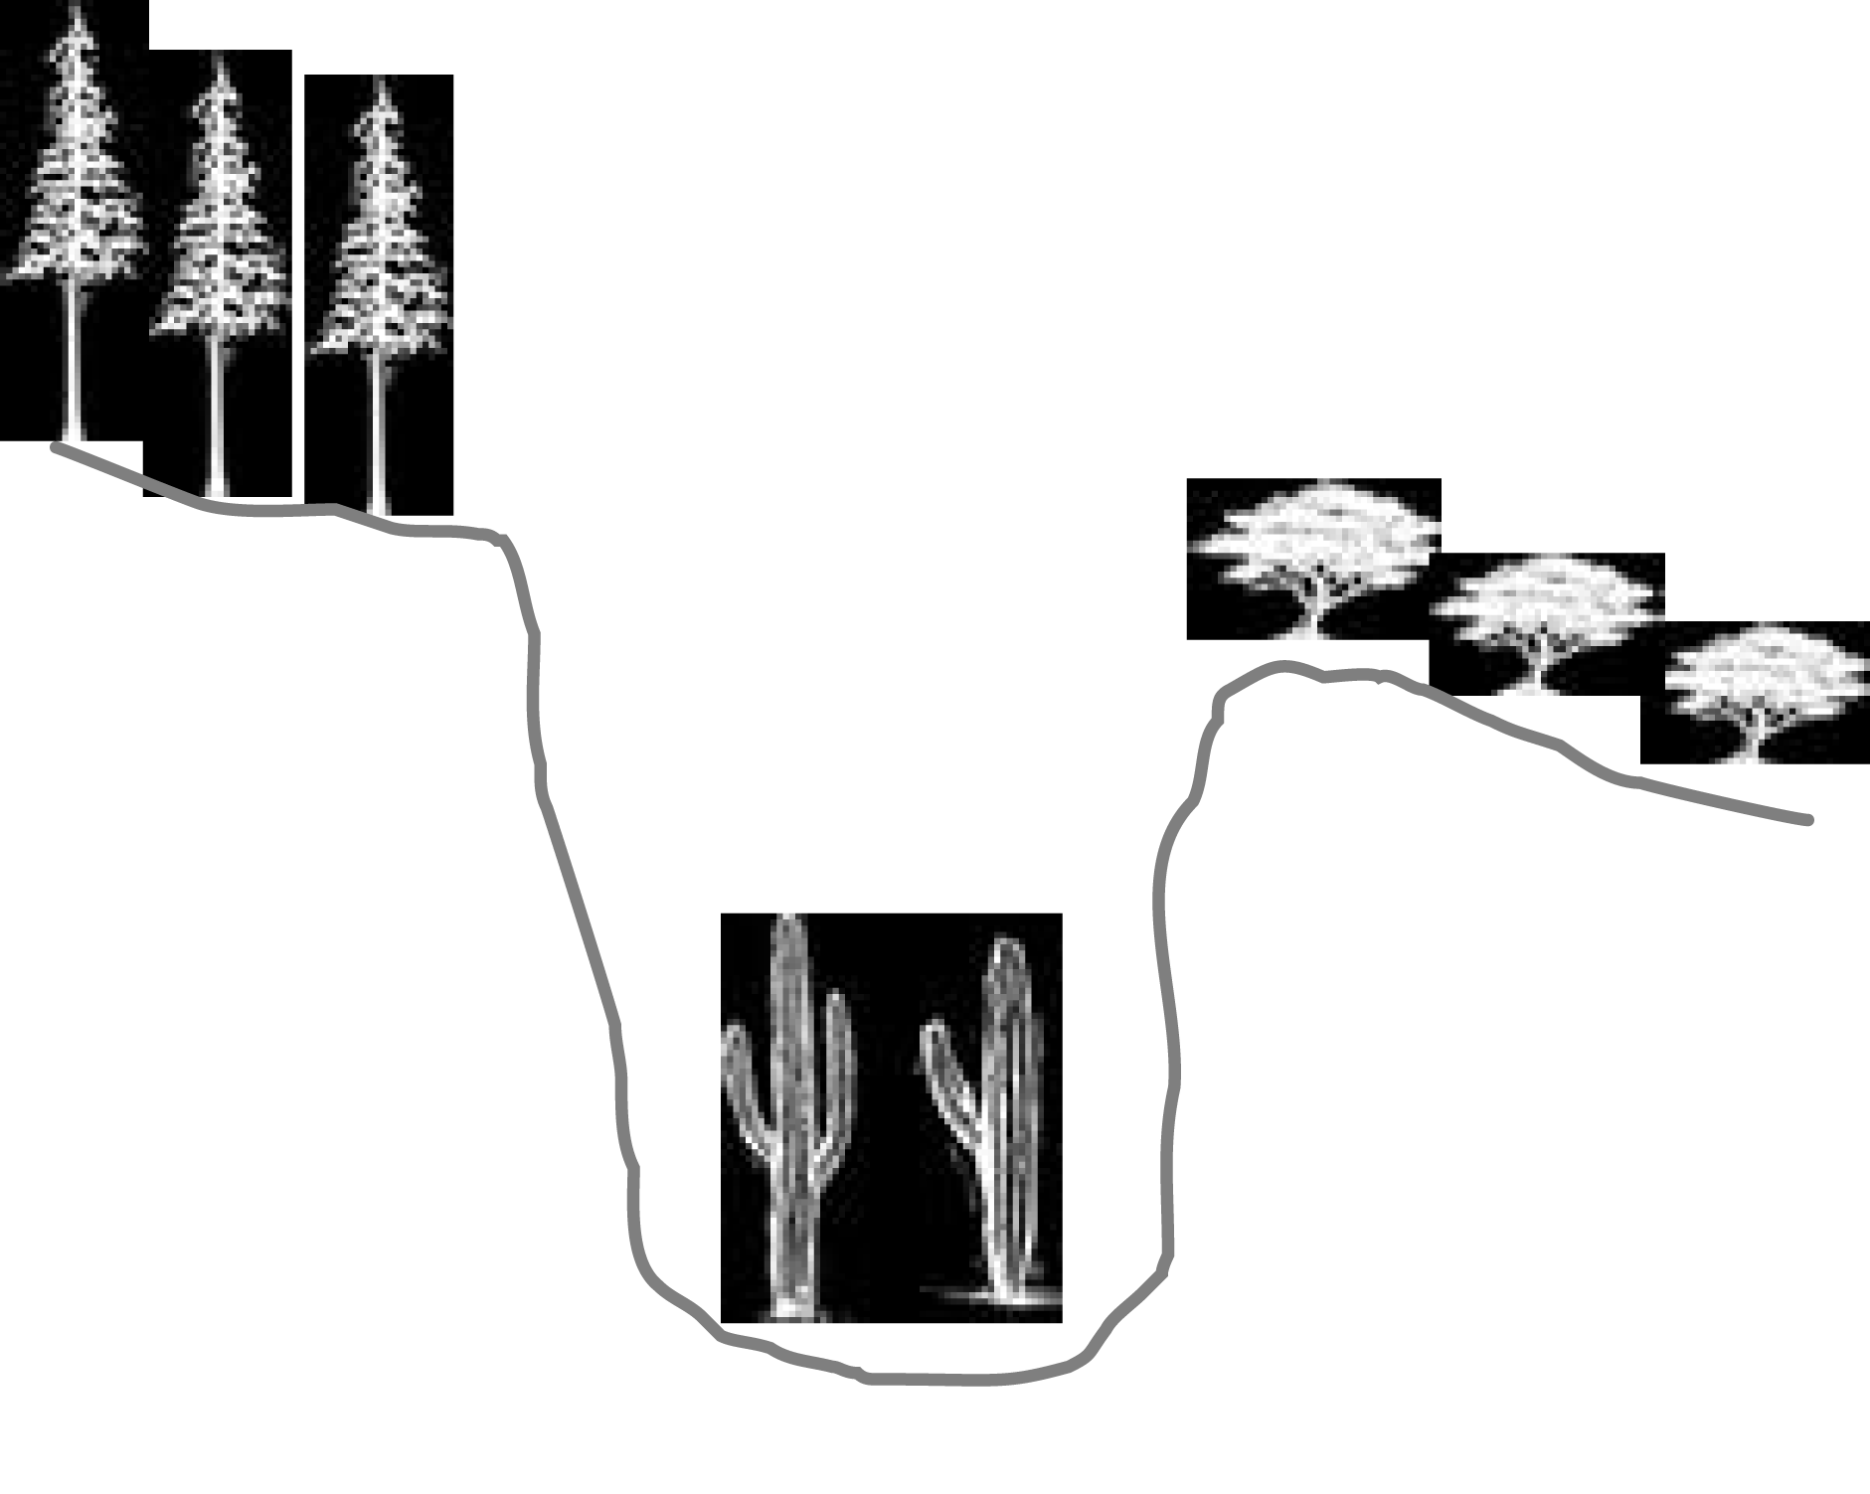
Any Science Gateway’s Dream
There are worlds between…
Research

Slide 31
5 Criteria for Successful
Science Gateways

Slide 32
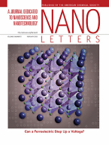











1: Outstanding Science
“Stuff the world wants”
Leveraged Research
$5.1M

Slide 33







2: Commitment to Dissemination
“faculty that want to give it away”
46 faculty
+ 6 site leads
106 grad students

Slide 34

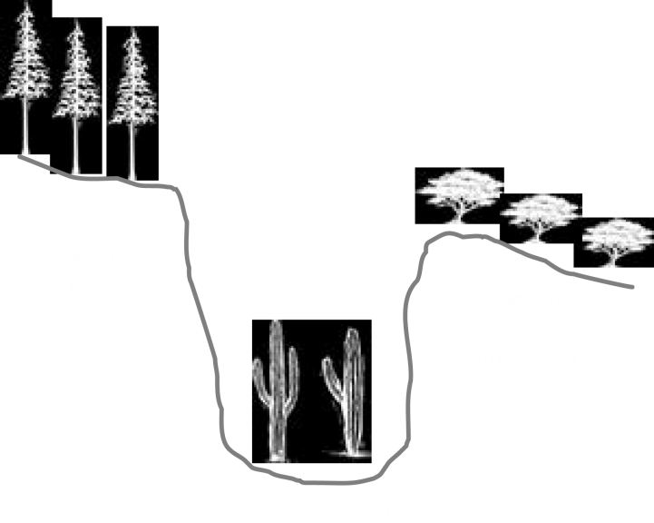
3: Technology for Dissemination

Slide 35
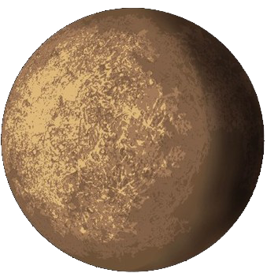
Typical Dissemination Paths
Customers
Peers
Local
Students
Remote
Students
Courses
Textbooks
Knowledge
IP
Publication
Web Content
Seminar
Information
Sim. Tools
Problems:
LONG stove pipe
Web content: afterthought
usually stale
Data shared by email
Tools spread by hiring
Data
REALLY
Tools
Instruments
Research
Team
Mod & Simulation
Experiments
Theory

Slide 36

nanoHUB Technical Solution
Customers
Peers
Local
Students
Remote
Students
Courses
Textbooks
Knowledge
IP
Publication
Web Content
Seminar
Information
Sim. Tools
Problems:
LONG stove pipe
Web content: afterthought
usually stale
Data shared by email
Tools spread by hiring
Data
REALLY
Tools
Instruments
Research
Team
Mod & Simulation
Michael
McLennan>>
Experiments
Theory

Slide 37

3: Technology for Dissemination
“simple and utterly dependable”
$1M/year
operation and
bridge building

Slide 38






















Hubs ‘R Us
hubzero.org
Feb 2007: 1 hub
Feb 2008: 5 hubs
Feb 2009: 8 hubs
Feb 2010: 21 hubs
Each hub has its own
funding stream
Outside institutions:
EPA, NYSTAR, Rice
HUBzero Consortium

Slide 39

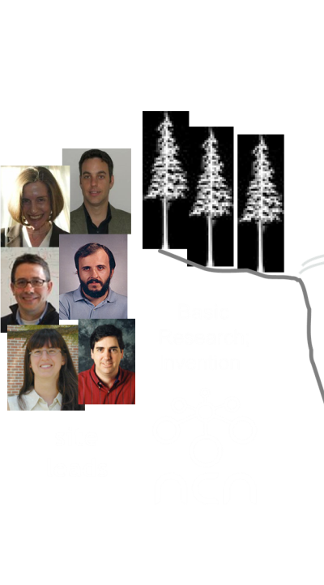
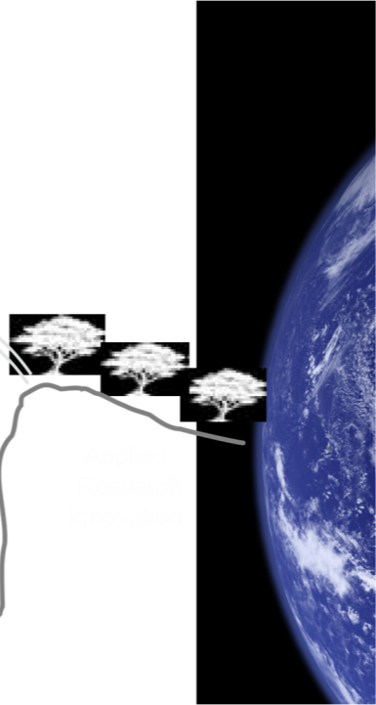







4: Tech Transfer Processes
“dedicated technical site leads”
Content Creation and Support
$2.2M

Slide 40




Knowledge Transfer Research
“educational research team”
Purdue Cost Share $100k
CAREER Leverage

Slide 41
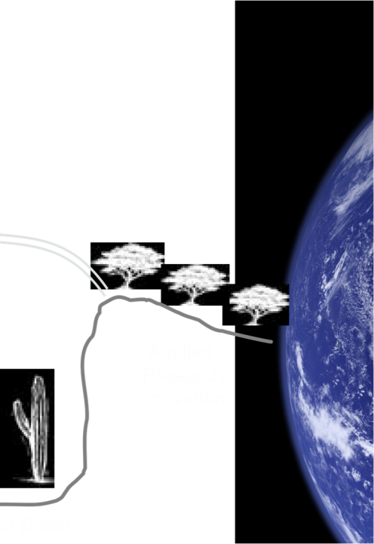
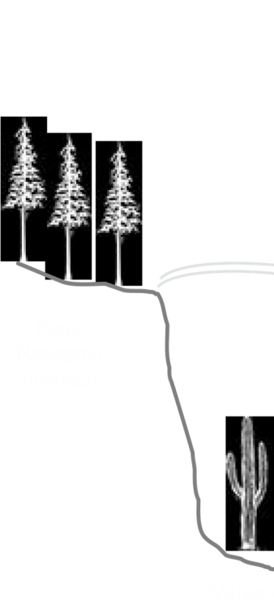



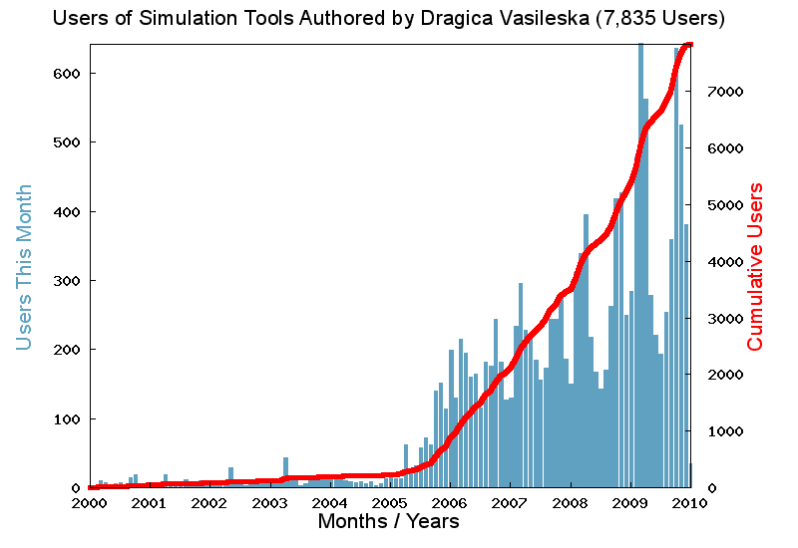

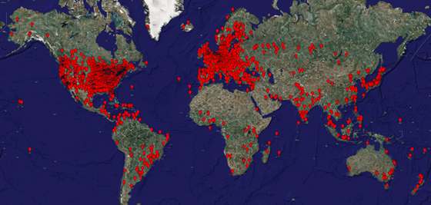
5: Open Assessment / Incentives
“gather, understand, disseminate stats”
Access,
Use,
Impact

Slide 42
World-Wide Learning Community
116,000 users worldwide
As much traffic as www.purdue.edu
Users at all Top 50 US Engr Schools
19% of all .edu domains
116 classes at 76 institutions in 2009
8,200 users ran 345,000 simulations
172 countries

